Slide 1

How To Improve Delivery Time of Olist E-Commerce
Doan Huynh Nhat Vu
Notes:
Chỉnh lại cỡ chữ của Olist

Slide 2
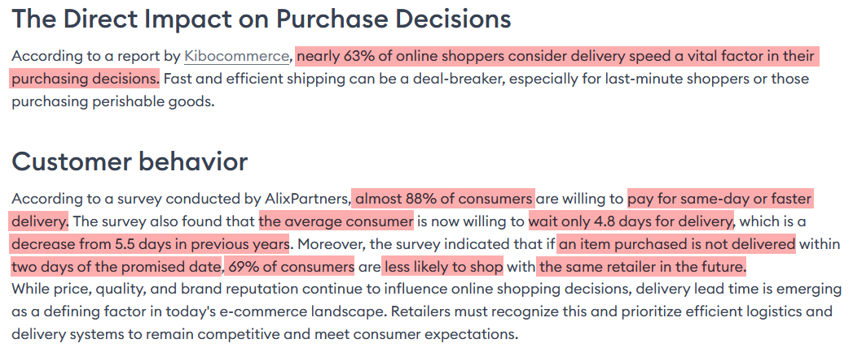



The importance of delivery for e-commerce
Source: The Critical Role of Delivery Lead Time in E-Commerce | Importance, Impact, and Consumer Behavior (starlinks-me.com)

Slide 3





Overview of the analysis
Objectives
Evaluate data to improve delivery times
Target Audience
Business/Logistics Analyst Manager of Olist
Metrics
Delivery_time = order_delivered_customer_date - order_approved_at
Ratio_of_late_delivery = Late_deliveries / Total_deliveries * 100%
Flow of Analysis
Analyze by Time ➔ Analyze by Location

Slide 4


About Olist Dataset
9 Tables
Overview: a Brazilian e-commerce platform that connects small and medium-sized businesses to customers across Brazil.
Period: Jan 2017 – Aug 2018
Number of rows: 110,289
Calculating New Fields
Name | Meaning
days_taken_to_approve_transaction | the duration the seller confirms the goods are available
days_taken_from_approval_to_drop_off | the duration Olist takes the goods from the seller
days_taken_for_items_to_reach_customer_after_drop_off | the duration Olist delivers the goods to the customer
delivery_time | the duration from the time the order is confirmed to the time it is delivered to the customer

Slide 5


Analyze by Time

Slide 6
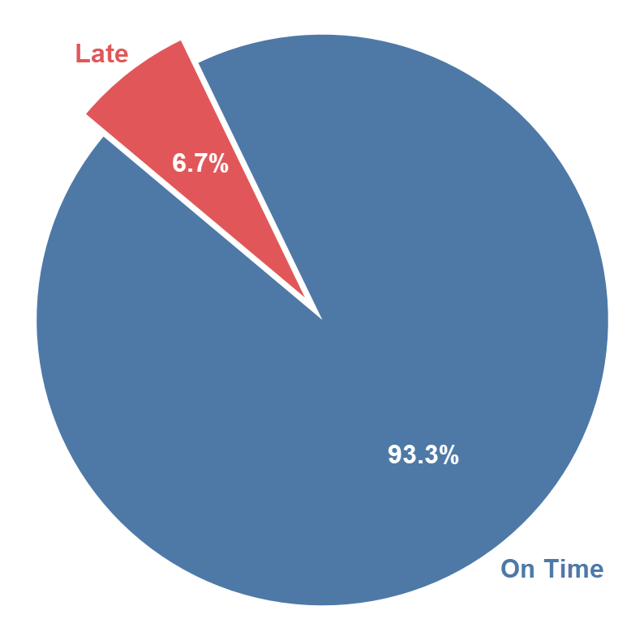

Percentage of On Time vs Late Deliveries
93.3% of total orders were delivered on-time.
Only 6.7% of total orders were delivered late.
Notes:
Chỉnh lại số trong pie-chart cho dễ nhìn hơn

Slide 7

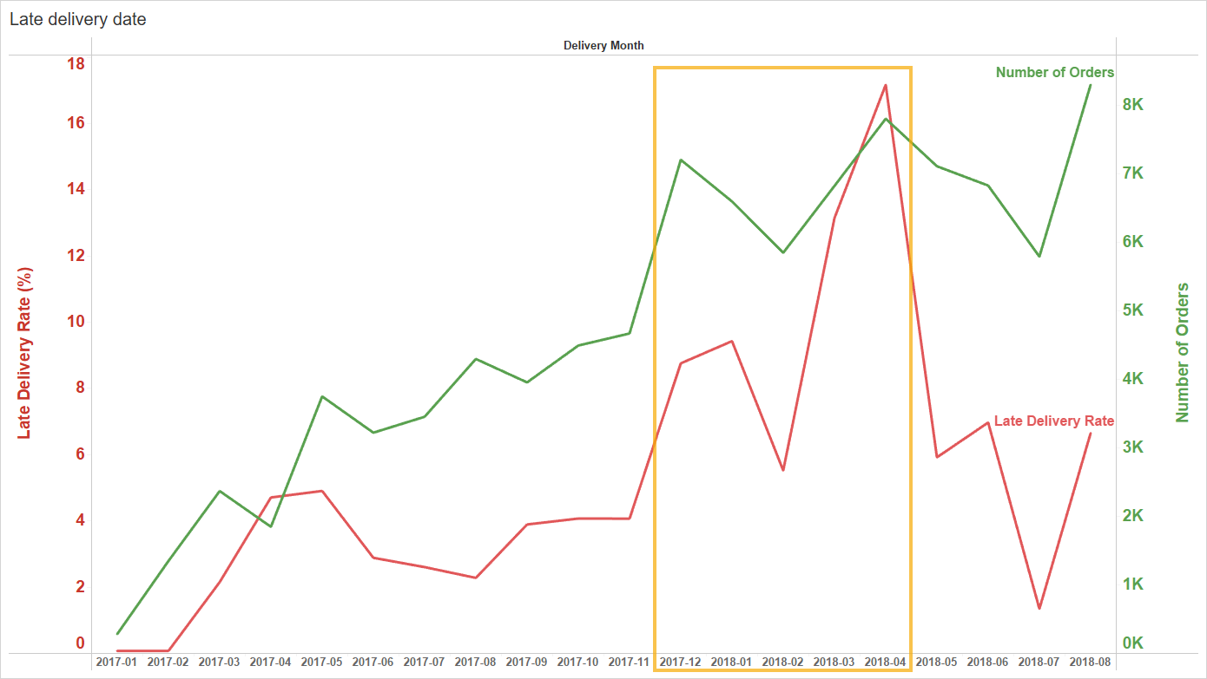
Late Delivery Rate
The increase in orders during the year-end shopping season of 2017 (Black Friday, Christmas, New Year, etc.) and the Carnival Festival at the end of February 2018 has led to a higher rate of late deliveries.
Notes:
Chỉnh lại text trên các trục lớn hơn, highlight khoảng time

Slide 8

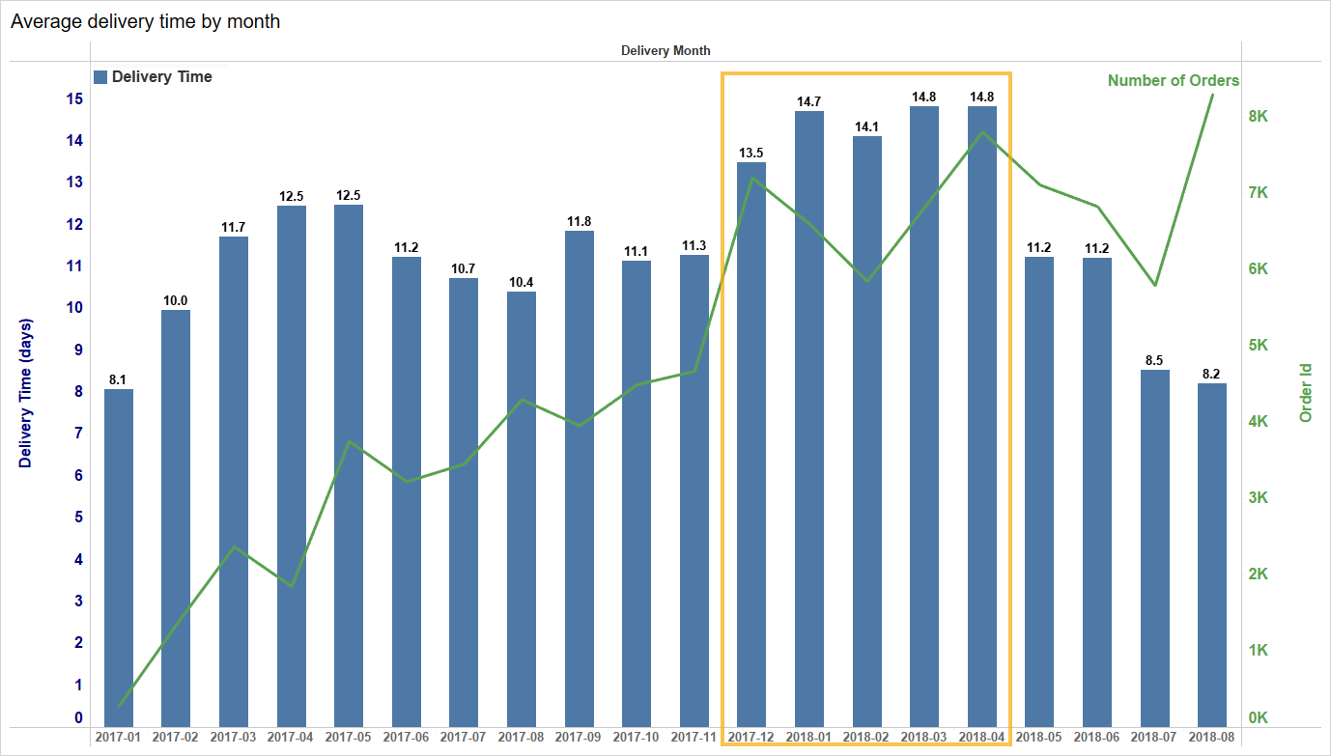


Average Delivery Time
The average delivery time varies by month and tends to increase during the year-end shopping season.

Slide 9
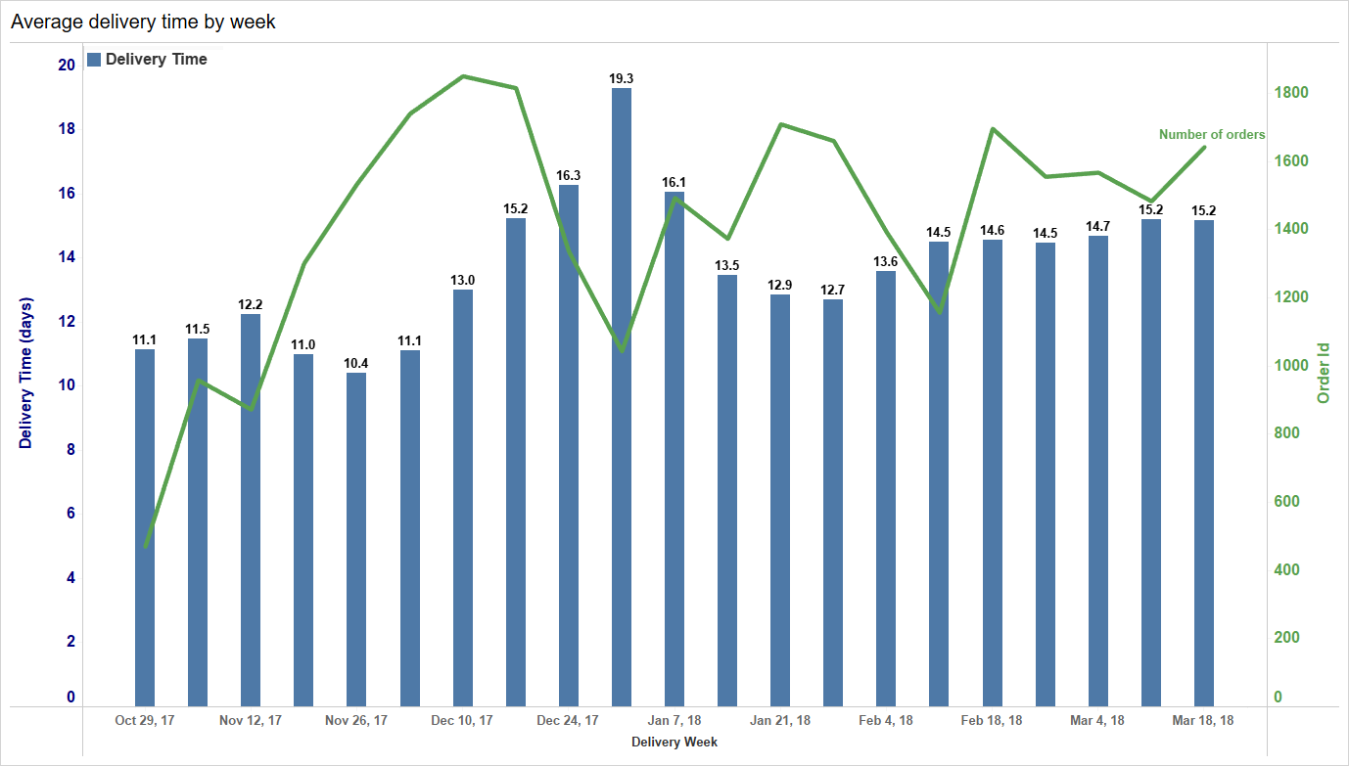
Average Delivery Time
The average weekly delivery time during the year-end shopping season (Black Friday, Christmas, New Year, and Carnival Festival).

Slide 10
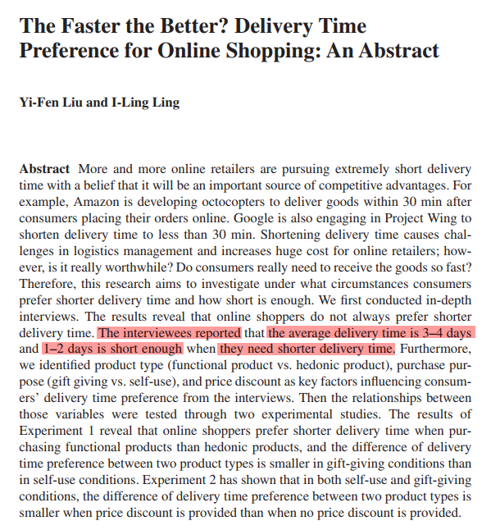
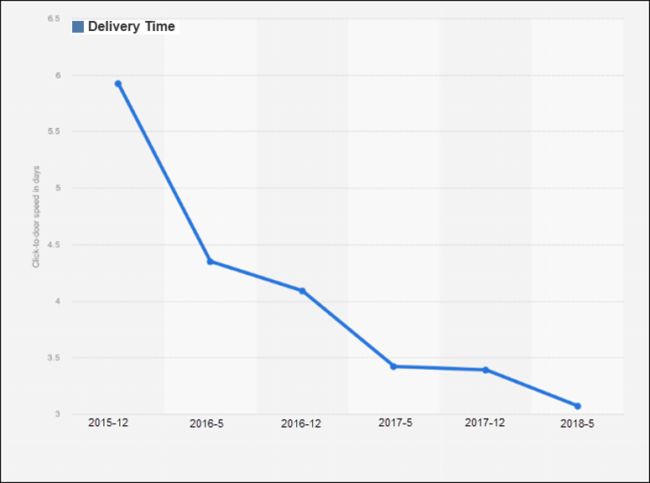
Average Delivery Time
Amazon’s average delivery-time 2018.
Source: https://www.statista.com/statistics/957782/parcel-carriers-on-time-delivery-rate-peak-season/
Source: https://link.springer.com/chapter/10.1007/978-3-319-47331-4_136
Notes:
Mảnh đường line hay highlight (chú ý độ đậm nhạt)…

Slide 11
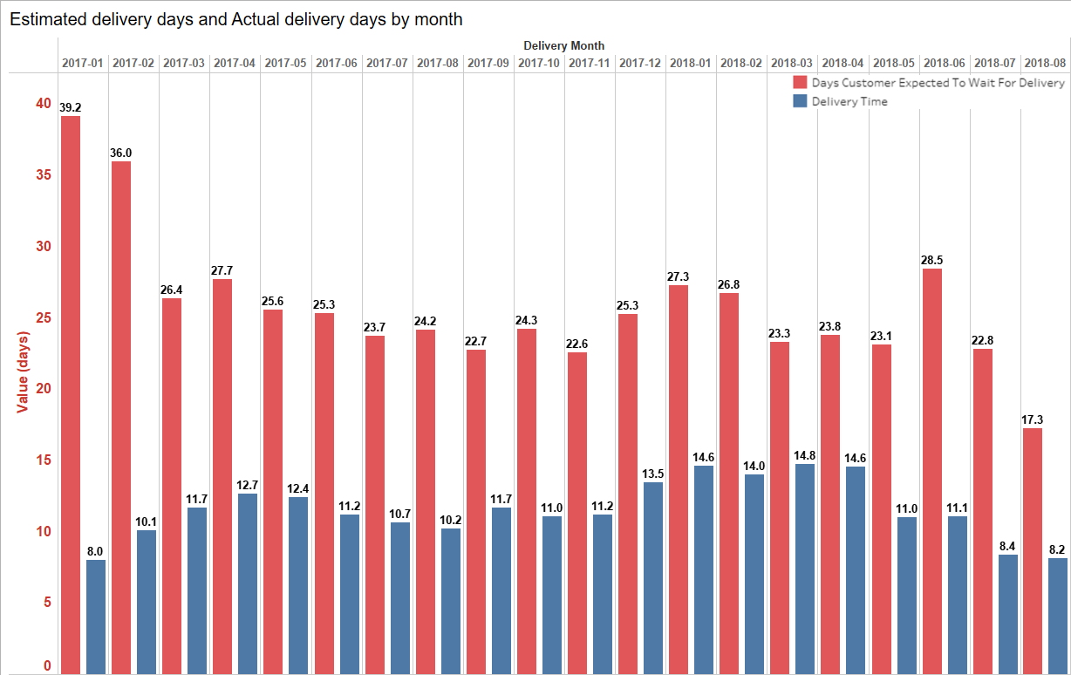

The estimated delivery
There is a significant discrepancy between the estimated delivery date and the actual delivery date based on monthly data.
Notes:
Thêm tiêu đề chart

Slide 12
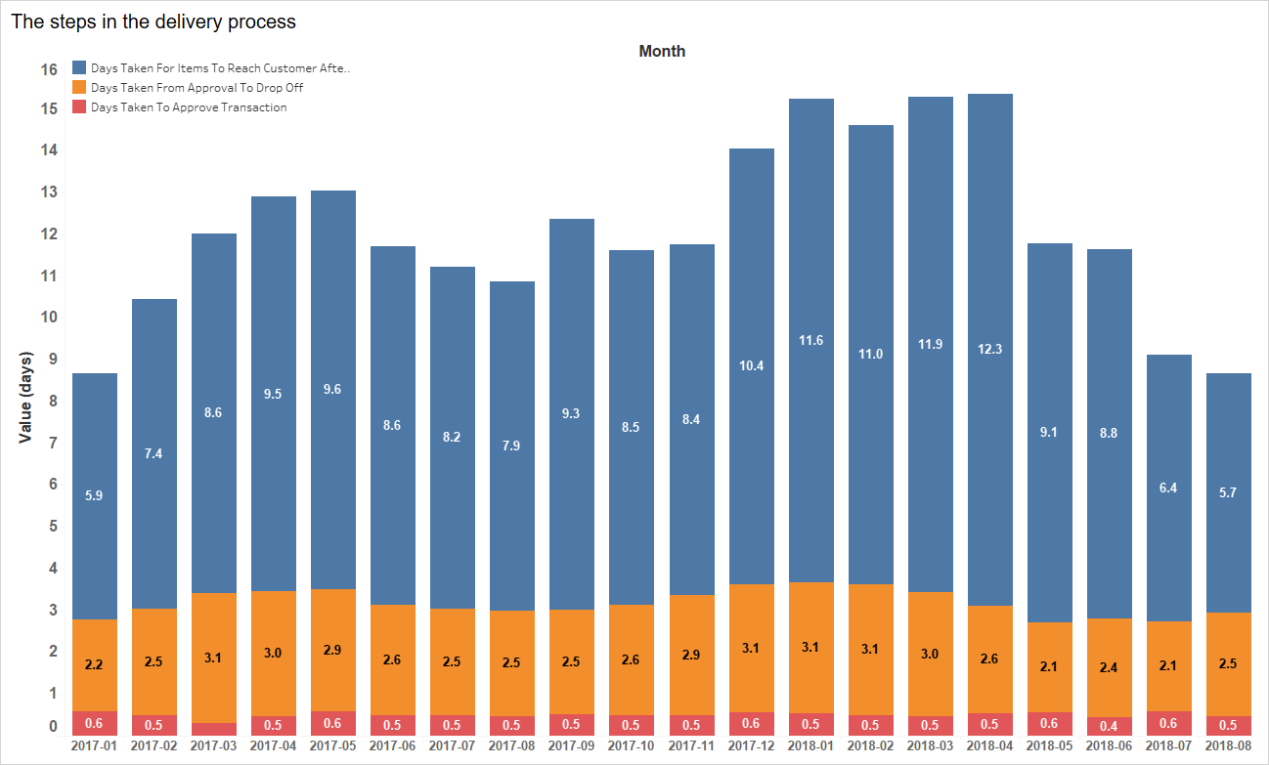

Time for each step in the order processing
The carrier takes approximately 2 to 3 days to pick up the order from the seller, and the delivery time to the customer ranges from 6 to over 11 days.
Notes:
Highlight thêm

Slide 13



Potential Solutions
Reduce estimated delivery times requires a combination of factors, including optimizing internal processes, improving transportation systems, and enhancing distribution networks.
Reduce the pickup time for the carrier to collect goods from the seller.
Automate warehouse processes: Implement automation systems in warehouses to minimize order processing time and prepare goods for shipment.

Slide 14

Analyze by Location

Slide 15
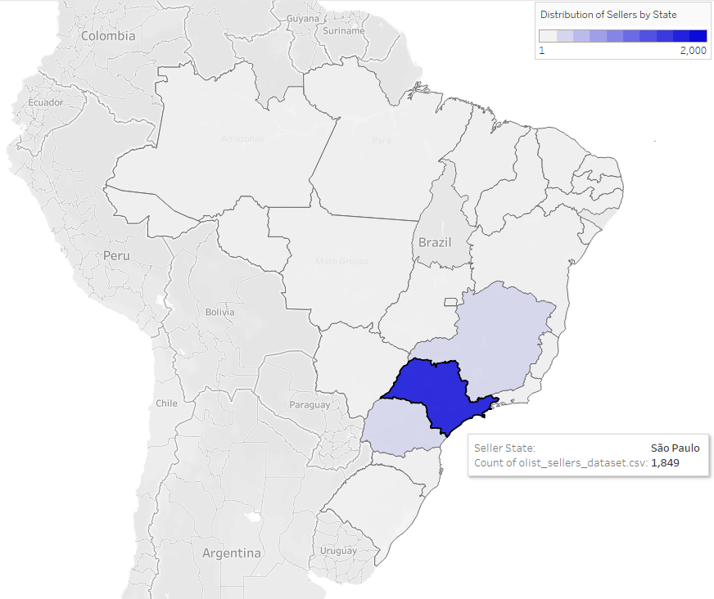
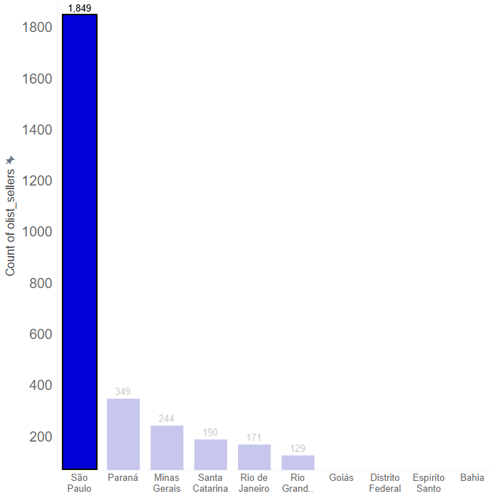
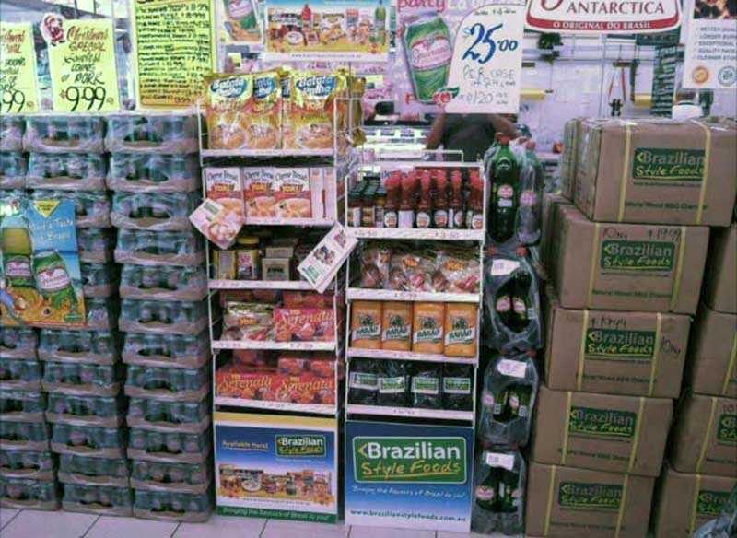
Distribution of Sellers by State
São Paulo is the state with the highest concentration of sellers, with 1,849 sellers.

Slide 16
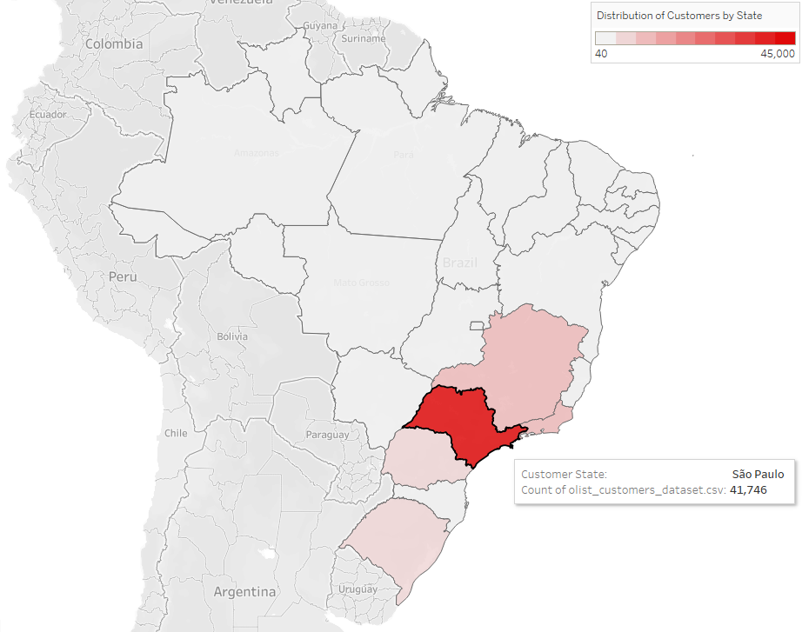
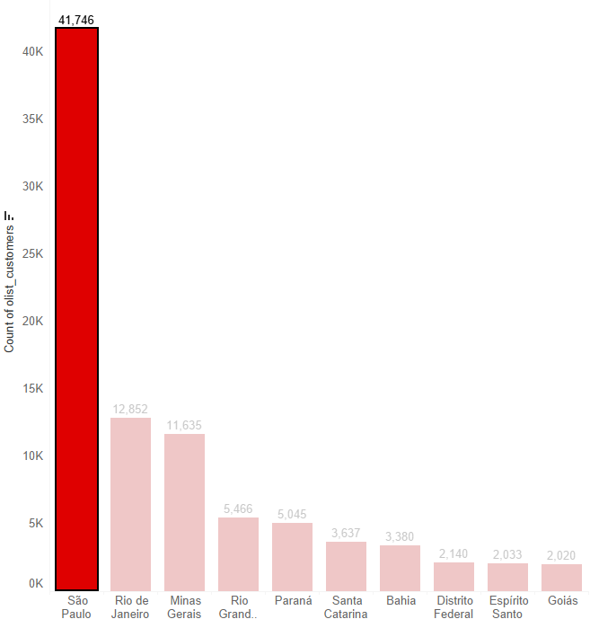

Distribution of Customers by State
São Paulo is also the state with the highest concentration of customers, with 41,746 customers.

Slide 17
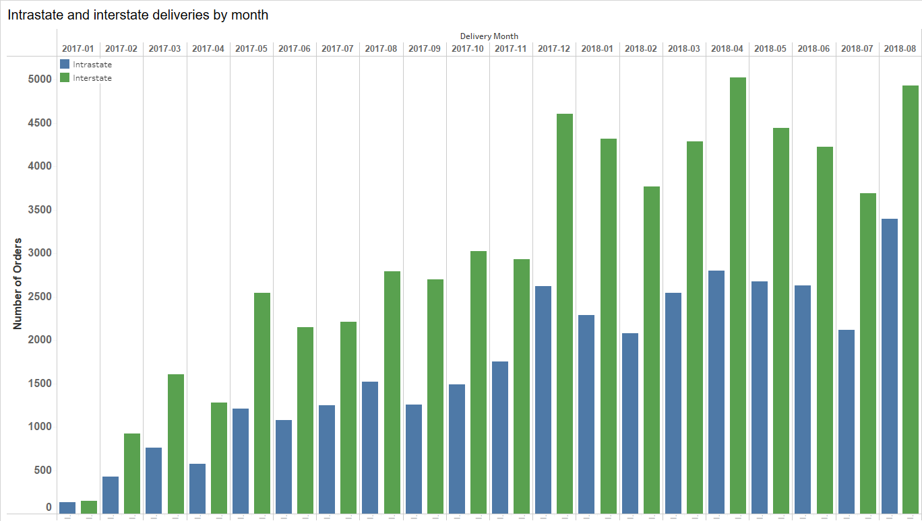
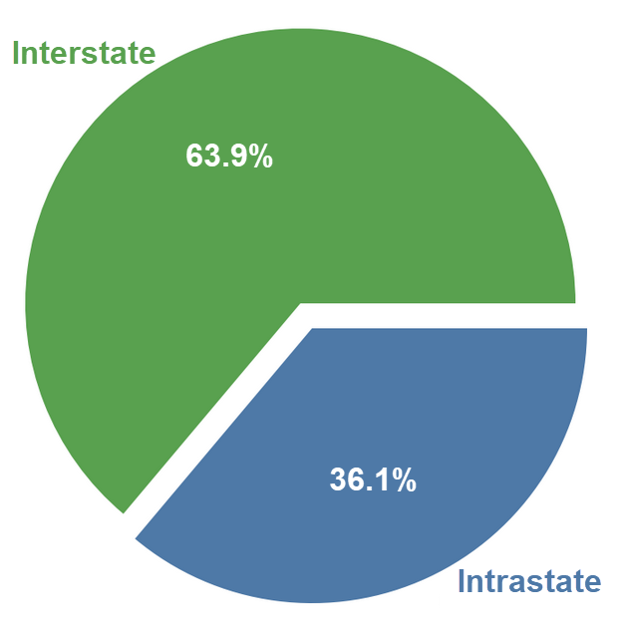
Intrastate vs Interstate Delivery
It can be seen that the total number of interstate orders is significantly higher than intrastate orders.

Slide 18
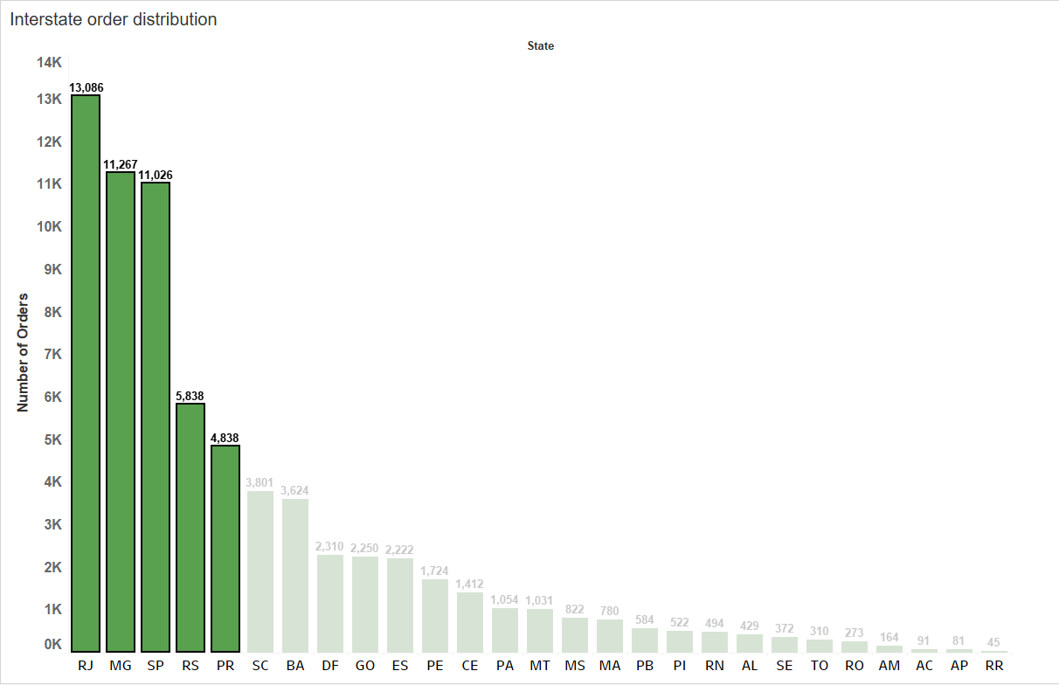
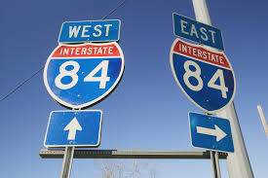
Interstate Delivery
The top 5 states RJ (Rio de Janeiro), MG (Minas Gerais), SP (São Paulo), RS (Rio Grande do Sul), PR (Paraná) have the highest number of interstate orders.

Slide 19
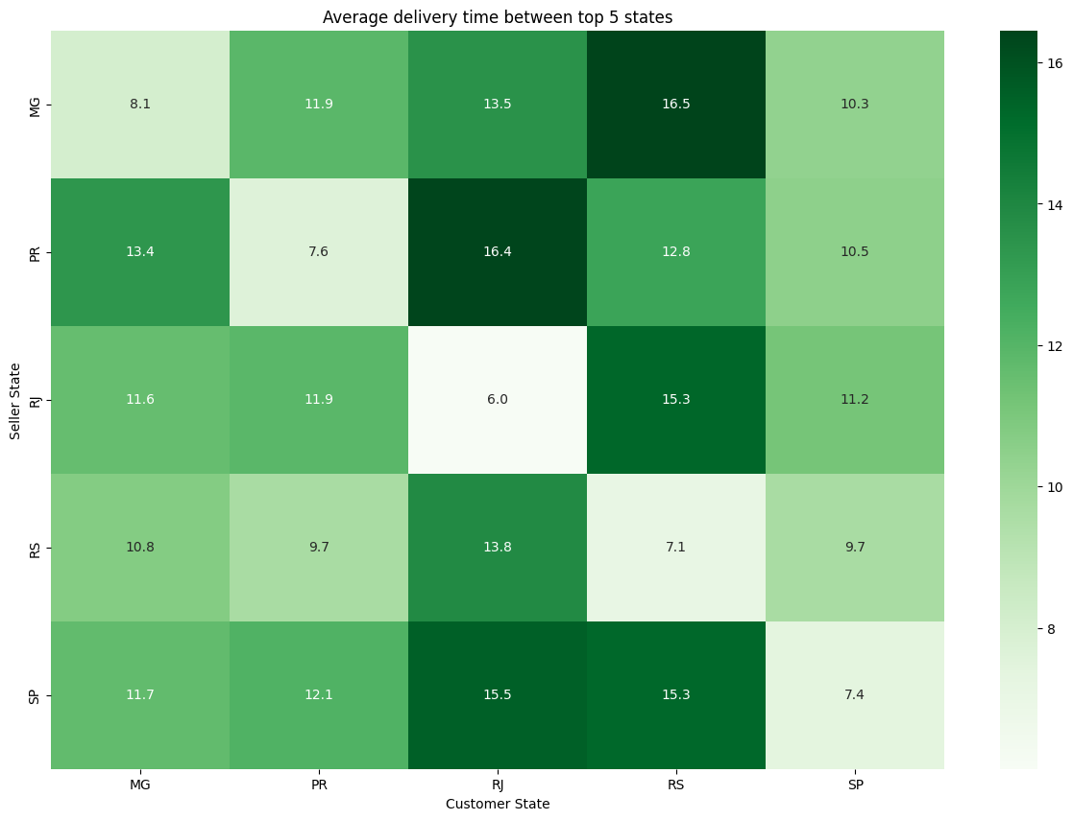
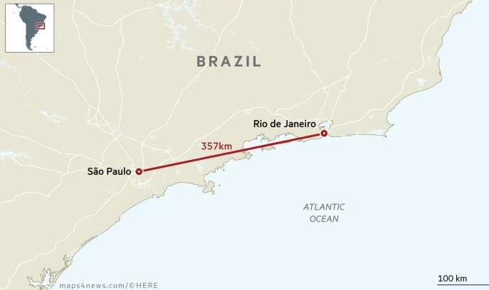
Average delivery time between top 5 states
Average delivery times in the five states with the most orders show significant delays. Intrastate deliveries within São Paulo take over 7 days, while deliveries from São Paulo to Rio de Janeiro exceed 15 days. Clearly, Olist's delivery times are excessively long.

Slide 20





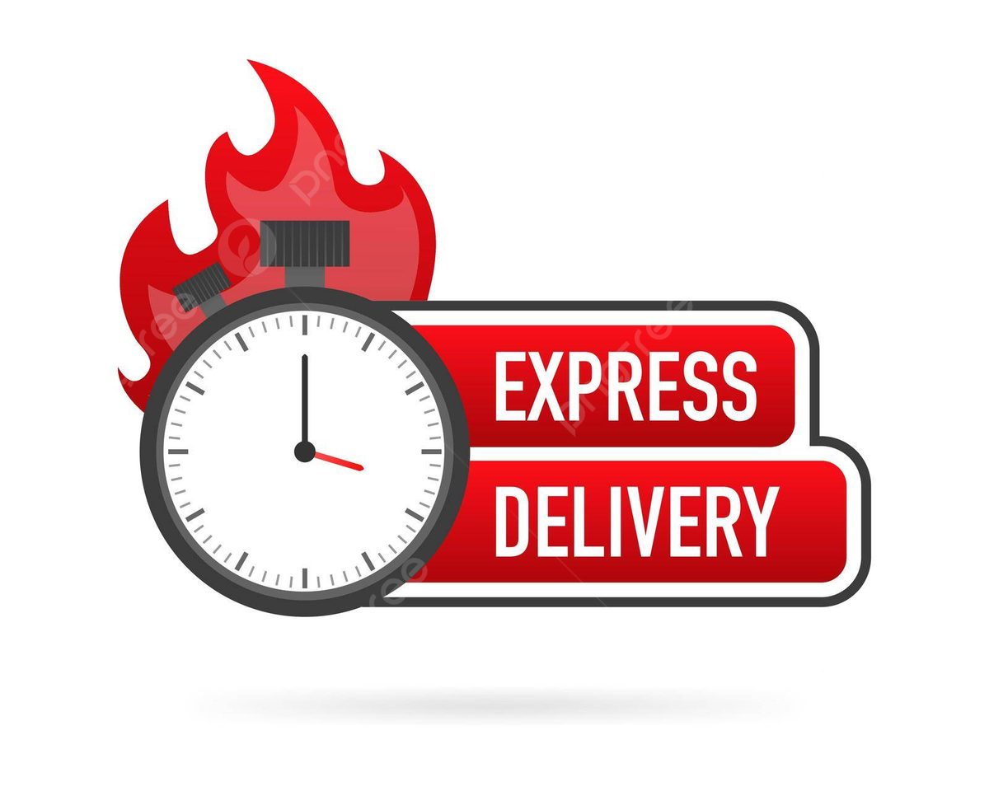
Potential Solutions
Provide multiple delivery options: Offer flexible delivery options such as express delivery and same-day delivery to meet the diverse needs of customers and reduce the pressure on delivery during peak seasons.
Establish distribution centers in areas with high densities of sellers and customers, particularly in São Paulo, to reduce the transportation time from sellers to customers.

Slide 21

Conclusion
This project focuses on improving Olist e-commerce delivery-time in the period from Jan-2017 to Aug-2018.
By Time:
Reduce estimated delivery times, optimize internal processes, improve transportation systems, and enhance distribution networks. Additionally, reduce carrier pickup times and automate warehouse processes to minimize order processing and shipment preparation.
By Location:
Offering multiple delivery options like express and same-day, to diverse customer needs. Establishing centralized delivery points in densely populated areas reduces delivery times to individual addresses.
These points provide concise solutions for enhancing delivery efficiency through analyses of time and location.

Slide 22


Thank You
Doan Huynh Nhat Vu
dhnv13494@gmail.com

